Slide 1
Exceptional Exceptions
with @LlewellynFalco & @JamesRCounts

Slide 2
Eddie Izzard’s printer
http://youtu.be/k6C_HjWr3Nk?t=3m30s

Slide 3
Rules
All code must compile
All exceptions must be thrown because of standard calls to the .Net BCL
All improvements must be possible

Slide 4
Playing the Game
Show code that caused the exception to be thrown
Ask why?
Propose better Exception Message
Ask again

Slide 5
The route to null evil

Slide 6
11
12
13
14
var a = Router.GetRoute("A");
var b = Router.GetRoute("B");
var c = Router.GetRoute("C");
var result = new Helper(a.From, b.To, c.ViaProxy).Send();
System.NullReferenceException: Object reference not set to an instance of an object.
at ExceptionalExamples.UnitTests.NullRef() in UnitTest1.cs: line 14
What is null?
A) a
B) b
C) c
D) I don’t know

Slide 7
IL_0028: ldloc.1 IL_0029: callvirt instance object ExceptionalExamples.Route::get_To()
Object reference not set to an instance of an object.
throw new NullReferenceException(“Object reference not set to an instance of an object.”)
Null reference while executing: Route.To
throw new NullReferenceException(
"Null reference while executing: {0}.{1}",
m.ClassName,
m.MethodSignature());

Slide 8
11
12
13
14
var a = Router.GetRoute("A");
var b = Router.GetRoute("B");
var c = Router.GetRoute("C");
var result = new Helper(a.From, b.To, c.ViaProxy).Send();
System.NullReferenceException:
Null reference while executing: Route.To
at ExceptionalExamples.UnitTests.NullRef() in UnitTest1.cs: line 14
What is null?
A) a
B) b
C) c
D) I don’t know

Slide 9
This exception proves the rule…
“Print variable values
in your error messages”
…to give the confused coder some guidance

Slide 10
A heapful of rectangles

Slide 11
58
59
60
61
62
63
64
65
66
67
for (var i = 0; i < 10000; i++)
{
int w = random.Next(this.Width);
int h = random.Next(this.Height);
var start = new Point(0, 0);
var end = new Point(w, h);
var b = new LinearGradientBrush(start, end, Color.Red, Color.Blue);
var rect = new Rectangle(random.Next(Width), random.Next(Height), w, h);
e.Graphics.FillRectangle(b, rect);
}
What went wrong?
A) 10,000 rectangles
B) Brush too big
C) Garbage Collection
D) Other
System.OutOfMemoryException: Out of memory.
at LinearGradientBrush..ctor(Point p1, Point p2, Color c1, Color c2)
at MyForm.OnPaint(PaintEventArgs e) in c:\...\UnitTest1.cs:line 64
at Control.PaintWithErrorHandling(PaintEventArgs e, Int16 layer)
at Control.OnPrint(PaintEventArgs e)

Slide 12
A) new LinearGradientBrush(new Point(0, 0), new Point(w, h), Color.Red, Color.Blue);
B) new LinearGradientBrush(new Rectangle(0, 0, w, h), Color.Red, Color.Blue, 1.0f);
Out of memory
throw new OutOfMemoryException(“Out of memory.”)
Rectangle '{X=0,Y=0,Width=189,Height=0}' cannot have a width or height equal to 0.
throw new ArgumentException(
@"Rectangle ‘{{X={0},Y={1},Width={2},Height={3}}}'
cannot have a width or height equal to 0.",
start.X, start.Y, end.X - start.X, end.Y - start.Y);

Slide 13
58
59
60
61
62
63
64
65
66
67
for (var i = 0; i < 10000; i++)
{
int w = random.Next(this.Width);
int h = random.Next(this.Height);
var start = new Point(0, 0);
var end = new Point(w, h);
var b = new LinearGradientBrush(start, end, Color.Red, Color.Blue);
var rect = new Rectangle(random.Next(Width), random.Next(Height), w, h);
e.Graphics.FillRectangle(b, rect);
}
What went wrong?
A) 10,000 rectangles
B) Brush too big
C) Garbage Collection
D) Other
Rectangle '{X=0,Y=0,Width=189,Height=0}' cannot have a width or height equal to 0.
at LinearGradientBrush..ctor(Point p1, Point p2, Color c1, Color c2)
at MyForm.OnPaint(PaintEventArgs e) in c:\...\UnitTest1.cs:line 64
at Control.PaintWithErrorHandling(PaintEventArgs e, Int16 layer)
at Control.OnPrint(PaintEventArgs e)
Height is 0

Slide 14
This exception proves the rule…
“If the framework gives you bad exceptions, throw better ones”
…to give the confused coder some guidance

Slide 15
This exception proves the rule…
“Print other variables to provide context”
Rectangle '{X=0,Y=0,Width=189,Height=0}'
…to give the confused coder some guidance

Slide 16
Cast into the (Void)

Slide 17
11
12
13
Component[] from = { new Button(), new Form(), new ToolTip(), };
Component[] to = new Collage().GetMemories();
Array.Copy(from, to, from.Length);
System.InvalidCastException: At least one element in the source array could not be cast down to the destination array type.
at System.Array.Copy(Array s, Array d, Int32 l)
at UnitTests.ArrayCopy() in UnitTest1.cs: line 13
What doesn’t fit?
A) Button
B) Form
C) ToolTip
D) I don’t know

Slide 18
13
Array.Copy(from, to, from.Length);
At least one element in the source array could not be cast down to the destination array type.
throw new InvalidCastException (“…text…”)
<Form> could not be cast to destination array type <Control[]>
throw new InvalidCastException(
"<{0}> could not be cast to destination array type <{1}>",
element.GetType().Name, to.GetType().Name);

Slide 19
11
12
13
Component[] from = { new Button(), new Form(), new ToolTip(), };
Component[] to = new Collage().GetMemories();
Array.Copy(from, to, from.Length);
System.InvalidCastException: <Form> could not be cast to destination array type <Control[]>
at System.Array.Copy(Array s, Array d, Int32 l)
at UnitTests.ArrayCopy() in UnitTest1.cs: line 13
What doesn’t fit?
A) Button
B) Form
C) ToolTip
D) I don’t know

Slide 20
This exception proves the rule…
“Runtime details make it clear where the error comes from”
…to give the confused coder some guidance

Slide 21
A date with a parser

Slide 22
75
var dateTime = DateTime.Parse(form.Date);
System.FormatException: The string was not recognized as a valid DateTime. There is an unknown word starting at index 7.
at System.DateTimeParse.Parse(String s, DateTimeFormatInfo dtfi, DateTimeStyles styles)
at System.DateTime.Parse(String s)
at ExceptionalExamples.UnitTests.DateTimeParse() in UnitTest1.cs: line 75
How do you need to sanitize the date?
A) Include CultureInfo
B) Remove “th”
C) Only use first three letters of the month
D) Other

Slide 23
75
var dateTime = DateTime.Parse(form.Date);
Which error message would you prefer?
A) Cannot parse "March 6th 2010" at index 7.
B) Cannot parse "March 6th 2010" at index 7.
See http://msdn.go/DateParseHelp for more details
C) Cannot parse "March 6th 2010“ at index 7
Valid formats include:
"<Month> <Day> <Year>" => “January 14 2010”
"<Month>/<Day>/<Year>" => “1/14/2010”
"<Year>-<Month>-<Day>" => “2010-01-24”
D) Other

Slide 24
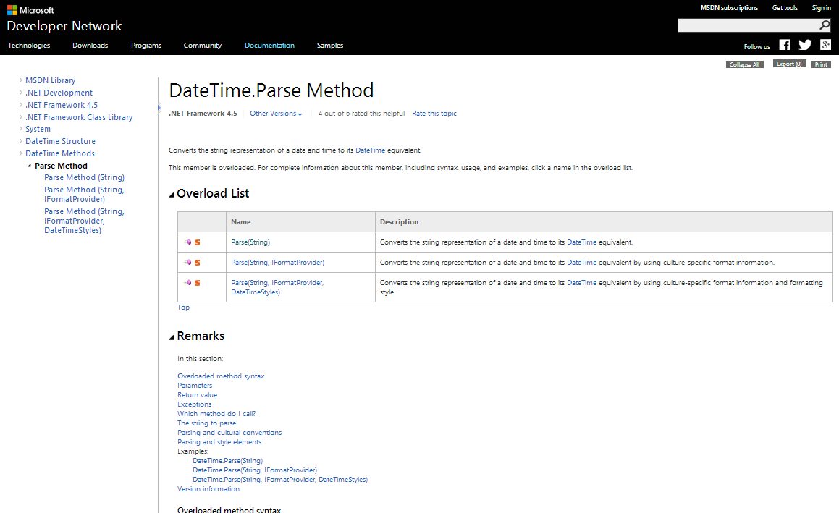

Slide 25
75
var dateTime = DateTime.Parse(form.Date);
System.FormatException: Cannot parse "March 6th 2010" at index 7
Valid formats include:
"<Month> <Day> <Year>" => "January 14 2010"
"<Month>/<Day>/<Year>" => "1/14/2010"
"<Year>-<Month>-<Day>" => "2010-01-24"
at System.DateTimeParse.Parse(String s, DateTimeFormatInfo dtfi, DateTimeStyles styles)
at System.DateTime.Parse(String s)
at ExceptionalExamples.UnitTests.DateTimeParse() in UnitTest1.cs: line 75
How do you need to sanitize the date?
A) Include CultureInfo
B) Remove “th”
C) Only us first three letters of the month
D) Other

Slide 26
This exception proves the rule…
“Show tl;dr examples if
particular formats are required”
…to give the confused coder some guidance

Slide 27
Touching your privates in public

Slide 28
82
83
84
85
86
var su = new SignUpPrompt();
su.Advertise();
var pb = new PrivateObject(su.BuyButton, new PrivateType(typeof(ButtonBase)));
var isAnimating = (bool)pb.Invoke("GetFlag", new[] { 0x0010 });
Assert.IsTrue(isAnimating);
private bool GetFlag(int flag)
What went wrong?
A) Not on ButtonBase
B) Wrong parameters
C) Docs are out of date
D) Other
System.MissingMethodException:
Method 'System.Windows.Forms.ButtonBase.GetFlag' not found.
at System.RuntimeType.InvokeMember(String name, BindingFlags bindingFlags, …)
at ExceptionalExamples.UnitTests.ButtonAnimation() in UnitTest1.cs: line 85

Slide 29
85
var isAnimating = (bool)pb.Invoke("GetFlag", new[] { 0x0010 });
Which error messages are helpful?
A) Cannot find method: GetFlag(int[])
B) Possible methods starting with “G” are:
GetFlag(int)
GetPreferedSizeCore(Size)
C) Common Fixes
If method not listed it might be on a base class
i.e. new PrivateObject(o, new PrivateType(typeof(BaseClass)))
If method is listed check your parameter list
i.e. p.Invoke(“MethodName”, param1, param2)
D) All of the above

Slide 30
82
83
84
85
86
var su = new SignUpPrompt();
su.Advertise();
var pb = new PrivateObject(su.BuyButton, new PrivateType(typeof(ButtonBase)));
var isAnimating = (bool)pb.Invoke("GetFlag", new[] { 0x0010 });
Assert.IsTrue(isAnimating);
System.MissingMethodException:
Cannot find method: GetFlag(int[]).
Possible methods starting with “G” are:
GetFlag(int)
GetPreferedSizeCore(Size)
Common Fixes
If method not listed it might be on a base class
i.e. new PrivateObject(o, new PrivateType(typeof(BaseClass)))
If method is listed check your parameter list
i.e. p.Invoke(“MethodName”, param1, param2)
at System.RuntimeType.InvokeMember(String name, BindingFlags bindingFlags, …)
at ExceptionalExamples.UnitTests.ButtonAnimation() in UnitTest1.cs: line 85
What went wrong?
A) Not on ButtonBase
B) Wrong parameters
C) Docs are out of date
D) Other

Slide 31
This exception proves the rule…
“Don’t hold back,
You don’t know which clue will help”
…to give the confused coder some guidance

Slide 32
82
83
84
85
86
var su = new SignUpPrompt();
su.Advertise();
var pb = new PrivateObject(su.BuyButton);
var isAnimating = (bool)pb.Invoke("GetFlag", 0x0010);
Assert.IsTrue(isAnimating);
System.MissingMethodException:
Cannot find method: GetFlag(int).
Possible methods starting with “G” are:
<none>
Common Fixes
If method not listed it might be on a base class
i.e. new PrivateObject(o, new PrivateType(typeof(BaseClass)))
If method is listed check your parameter list
i.e. p.Invoke(“MethodName”, param1, param2)
at System.RuntimeType.InvokeMember(String name, BindingFlags bindingFlags, …)
at ExceptionalExamples.UnitTests.ButtonAnimation() in UnitTest1.cs: line 85
What went wrong?
A) Not on Button
B) Wrong parameters
C) Docs are out of date
D) Other

Slide 33
Don’t disturb the natives
…or Dynamically Lost Library

Slide 34
82
...
100
101
NativeDll.svn_client_info();
[DllImport("libsvn_client-1-0.dll")]
public static extern int svn_client_info();
06/25/2014 09:59 PM 10,240 ExceptionalExamples.dll
06/03/2014 06:11 AM 255,849 libsvn_client-1-0.dll
2 File(s) 266,089 bytes
Why can’t we find the DLL?
A) Wrong File Permissions
B) Wrong Working Directory
C) Wrong Processor Arch
D) Other
System.DllNotFoundException:
Unable to load DLL 'libsvn_client-1-0.dll':
The specified module could not be found.
(Exception from HRESULT: 0x8007007E)
at ExceptionalExamples.NativeDll.svn_client_info()
at ExceptionalExamples.UnitTests.NativeTest() in UnitTest1.cs: line 82

Slide 35
100
[DllImport("libsvn_client-1-0.dll")]
Which error messages are helpful?
A) Problems loading dependencies for “libsvn_client-1-0.dll”.
B) Could not find dependency: “MSYS-1.0.dll”
C) Required libraries:
MSYS-1.0.dll
LIBSVN_DELTA-1-0.DLL
LIBSVN_DIFF-1-0.DLL
LIBAPR-0-0.DLL
LIBSVN_SUBR-1-0.DLL
D) All of the above

Slide 36
82
...
100
101
NativeDll.svn_client_info();
[DllImport("libsvn_client-1-0.dll")]
public static extern int svn_client_info();
06/25/2014 09:59 PM 10,240 ExceptionalExamples.dll
06/03/2014 06:11 AM 255,849 libsvn_client-1-0.dll
2 File(s) 266,089 bytes
System.DllNotFoundException:
Problems loading dependencies for “libsvn_client-1-0.dll”.
Could not find dependency: “MSYS-1.0.dll”
Required libraries:
MSYS-1.0.dll
LIBSVN_DELTA-1-0.DLL
LIBSVN_DIFF-1-0.DLL
LIBAPR-0-0.DLL
LIBSVN_SUBR-1-0.DLL
at ExceptionalExamples.NativeDll.svn_client_info()
at ExceptionalExamples.UnitTests.NativeTest() in UnitTest1.cs: line 82
Why can’t we find the DLL?
A) Wrong File Permissions
B) Wrong Working Directory
C) Wrong Processor Arch
D) Other

Slide 37
This exception proves the rule…
“Highlight root causes”
…to give the confused coder some guidance

Slide 38
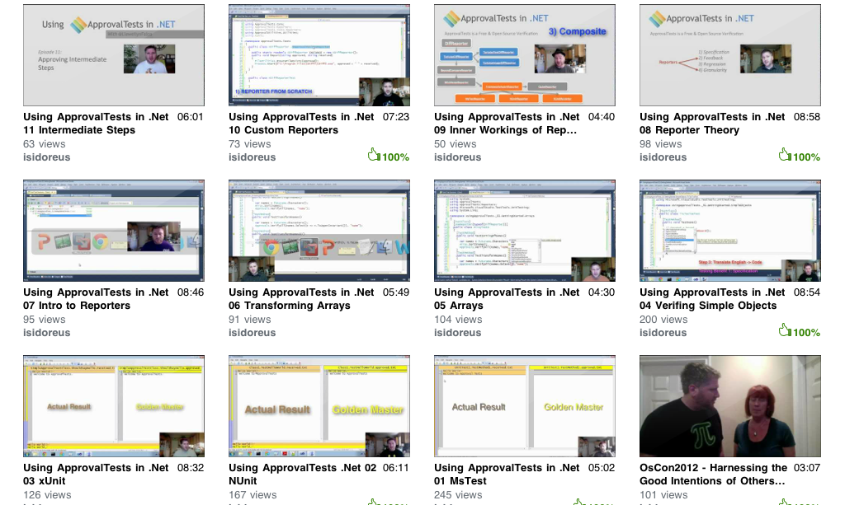
Approval Tests
20 episode youtube series

Slide 39


Slide 40
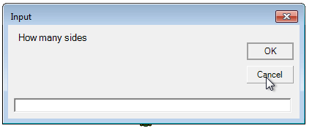


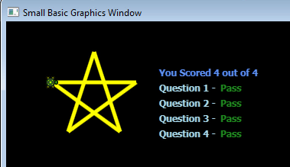
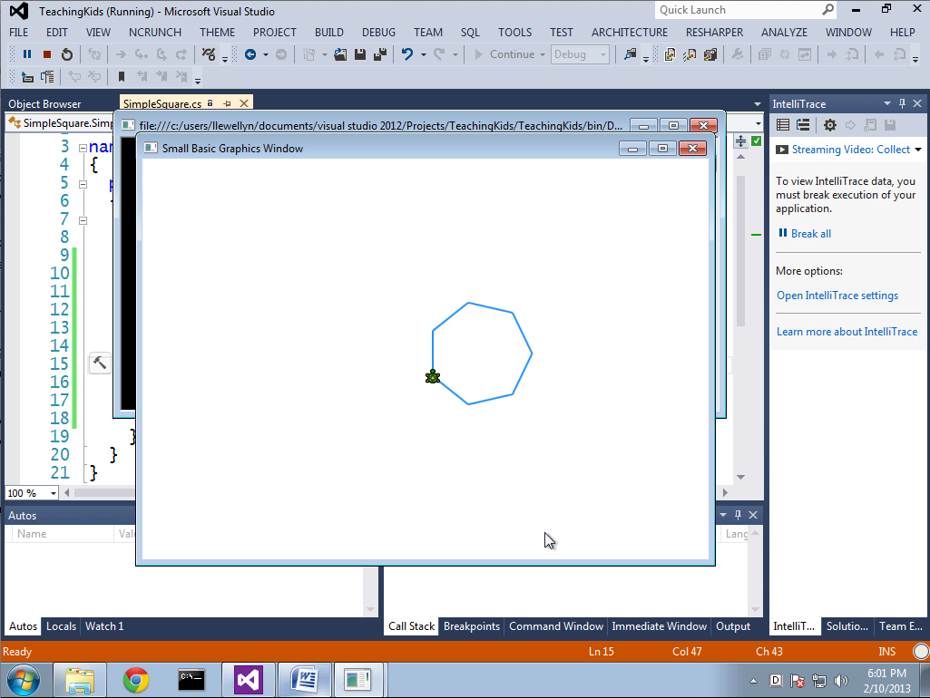

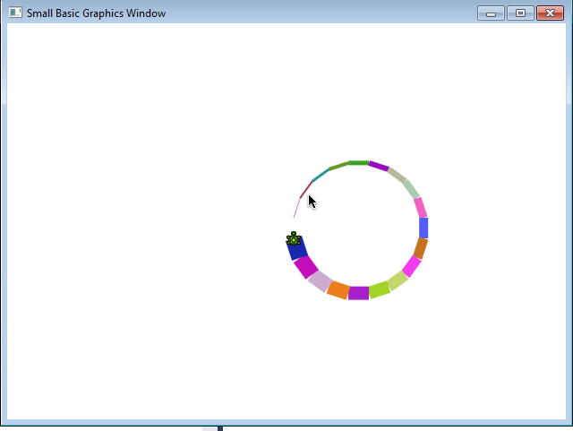
pluralsight.com/kids

Slide 41


Contact Information
Slides at http://lfal.co/ExceptionalExceptions
@JamesRCounts
http://IHadThisIdeaOnce.com
@LlewellynFalco http://LlewellynFalco.Blogspot.com

Slide 42
This exception proves the rule…
“Give example code
for any setup needed”
…to give the confused coder some guidance

Slide 43
This exception proves the rule…
“Point to online documentation”
…to give the confused coder some guidance

